Slide 1
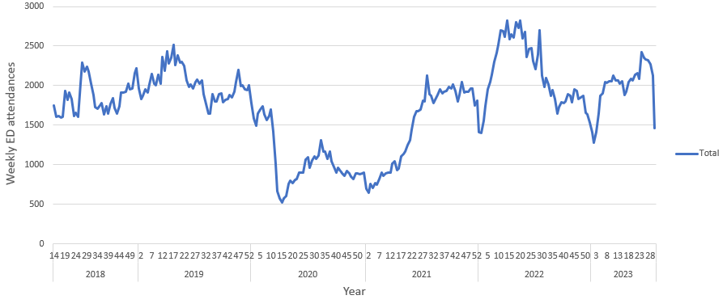
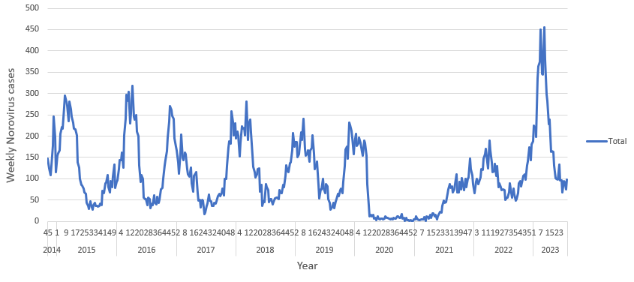
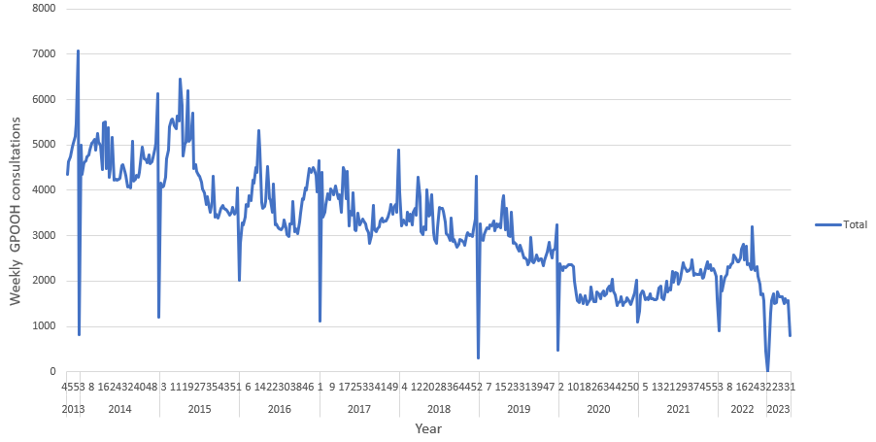
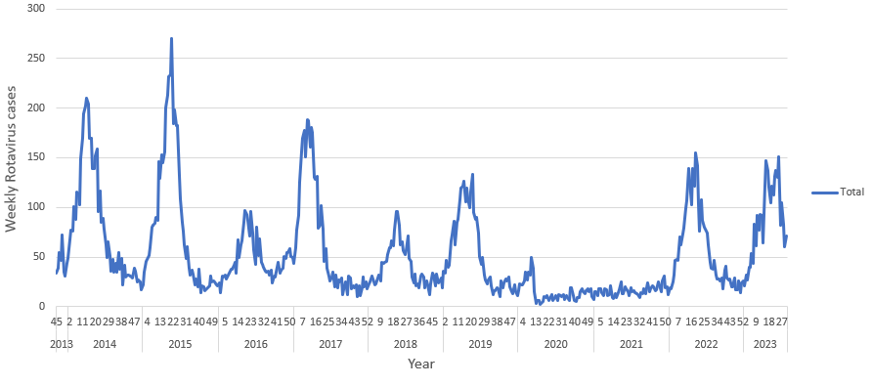
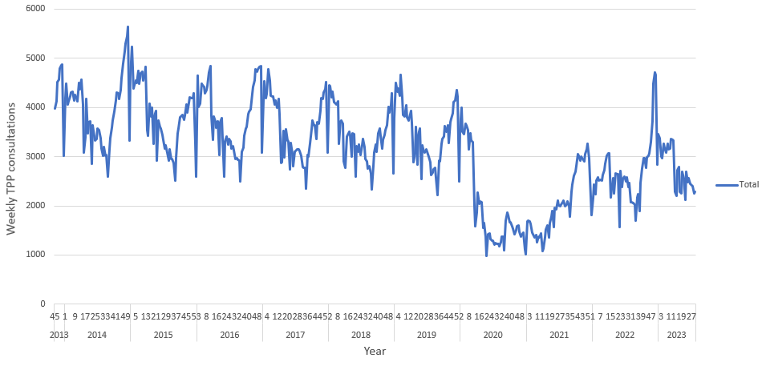
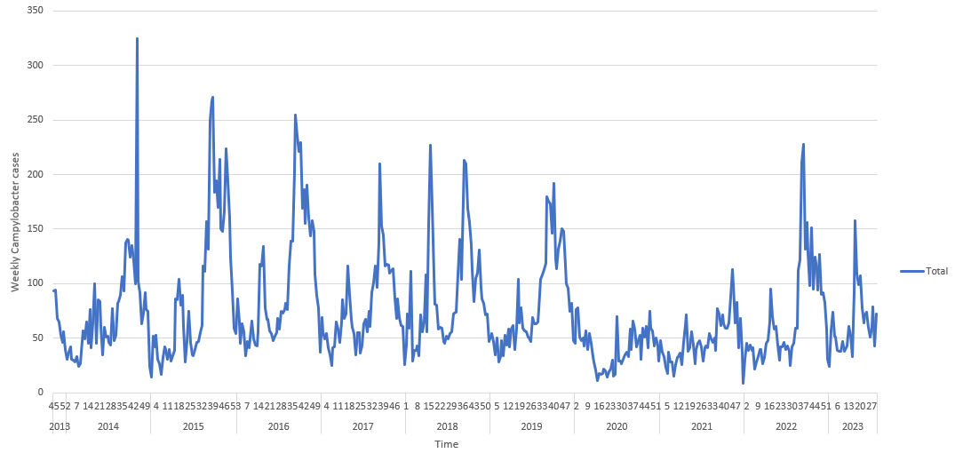
Determining the utility of UKHSA syndromic surveillance systems for monitoring changes in trends of commonly occurring gastrointestinal pathogens circulating in the community
Olubusola Adedire^{1,2}, Nicola Love¹, Amy Douglas³, Roger Morbey^{2,4}, Richard Elson⁴, Helen Hughes^{1,2} Alex J. Elliot^{1,2,4}
¹NIHR HPRU in Gastrointestinal Infections, University of Liverpool; ²UKHSA Real-time Syndromic Surveillance Team; ³UKHSA Gastrointestinal Infections and Food Safety (One Health) Division; ⁴NIHR HPRU in Emergency Preparedness and Response, University of East Anglia
INTRODUCTION
RESULTS
In the UK, the surveillance of gastrointestinal (GI) infections relies mainly on the laboratory reporting of specific GI pathogens.
Real-time syndromic surveillance offers additional support by monitoring a broader spectrum of GI illness in the community through patients presenting GI symptoms to various NHS healthcare facilities.
A drawback of syndromic surveillance is the lack of specificity in syndromic indicators for individual pathogens, posing challenges in interpreting trends related to GI syndromes.
Figure: selected plots of syndromic GI indicators and laboratory counts for: A) syndromic surveillance for I) emergency department attendances, II) GP out-of-hours contacts and III) GP in-hours consultations for gastroenteritis; B) laboratory reports for I) norovirus, II) rotavirus and III) campylobacter
A) Syndromic surveillance indicators
B) Laboratory reports
I) Emergency department attendances for gastroenteritis
I) Norovirus
II) GP out-of-hours consultations for gastroenteritis
II) Rotavirus
METHODS
The aim of the study is to evaluate which UKHSA syndromic surveillance system(s) and specific GI syndromic indicator(s) are most sensitive to commonly circulating GI pathogens.
Syndromic GI indicator data (vomiting, diarrhoea, and gastroenteritis) were extracted from the suite of UKHSA syndromic surveillance systems including NHS 111 calls, emergency department (ED) attendances, General Practitioner (GP) in-hours (GPIH) and GP out-of-hours (GPOOH).
The study period covered 4 November 2013 to 28 July 2023. Complementary laboratory data was extracted from the UKHSA National Enhanced Surveillance System (NESSS) for the following GI pathogens: norovirus, rotavirus, Campylobacter, Cryptosporidium, Salmonella and Giardia by specimen date.
III) Campylobacter
III) GP in-hours consultations for gastroenteritis
DISCUSSION
Preliminary epidemiological descriptive analyses of seasonality and trends observed across time and age groups have revealed distinct patterns, with a significant reduction in GI health seeking behaviour observed in the COVID-9 pandemic years.
Comparable patterns were noted in GPOOH and GPIH consultations for gastroenteritis and diarrhoea, although GPOOH had a higher frequency of vomiting consultations over GPIH.
NHS 111 calls exhibit the highest frequency of vomiting and diarrhoea health care seeking behaviour compared to GPOOH and GPIH consultations.
The peak occurrence of norovirus cases during winter months coincides with the peaks observed in syndromic gastroenteritis, vomiting, and diarrhoea cases.
The next phase of this work entails conducting correlation analyses to assess the statistical relationship between syndromic surveillance systems and corresponding GI indicators and specific laboratory pathogens.
The research was funded by the National Institute for Health and Care Research Health Protection Research Unit (NIHR HPRU) in Gastrointestinal Infections at University of Liverpool in partnership with the UK Health Security Agency (UKHSA), in collaboration with University of Warwick. The views expressed are those of the author(s) and not necessarily the NIHR, the Department of Health and Social Care or the UK Health Security Agency.

